Slide 1
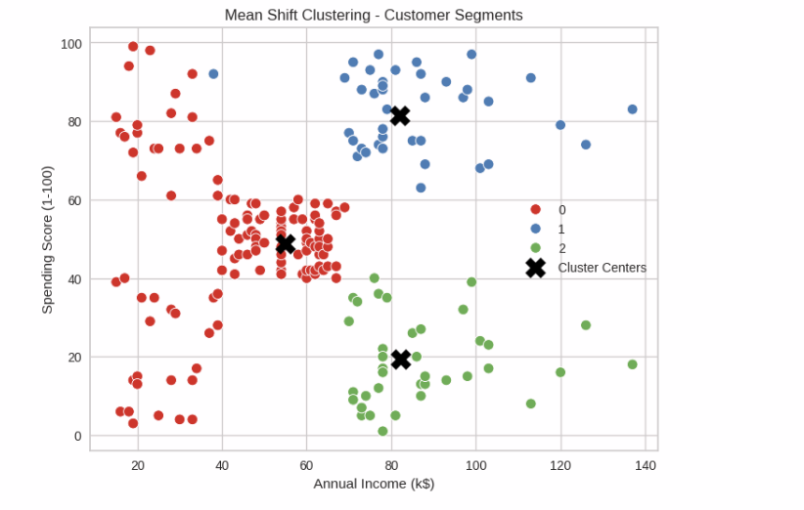
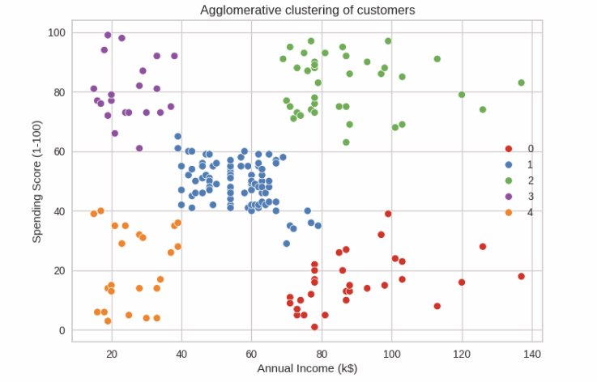
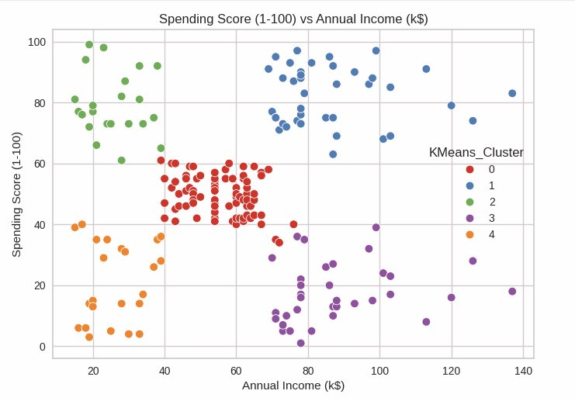
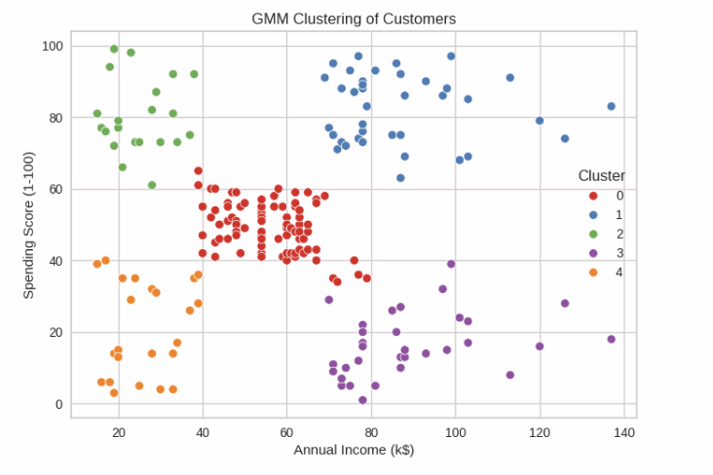
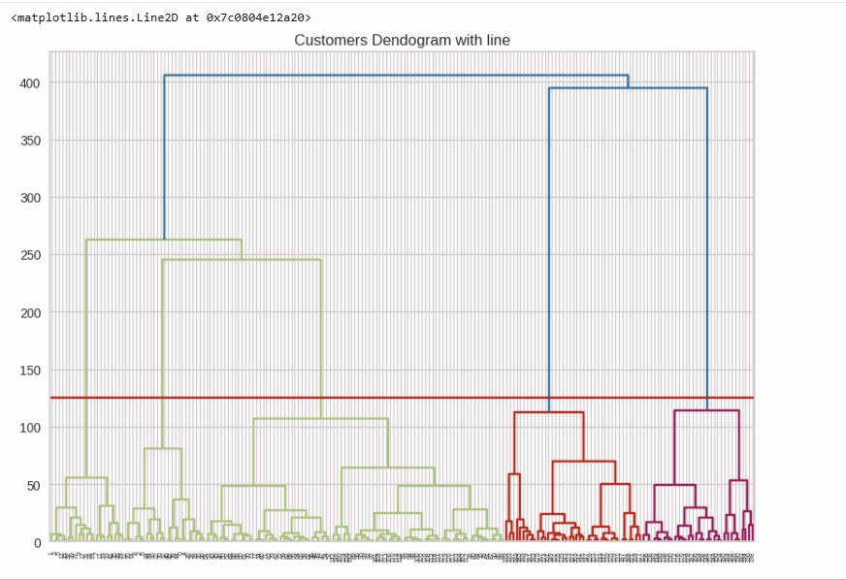
Customer Segmentation of Mall Shoppers Using Unsupervised Machine Learning
Hello World Team (Lohithaksh Annarapu, Vaidya Sree Ganesh, Vasanth Vasa)
Abstract
Results
Model Comparison
Conclusion
Customer segmentation is a key retail analytics technique enabling businesses to identify distinct shopper groups based on purchasing behavior. This study applies five unsupervised ML algorithms to the Mall Customers dataset (n=200), using Annual Income and Spending Score as primary clustering features. Five distinct segments were identified - VIP, Target, Impulsive, Budget, and Regular customers. K-Means (k=5) achieved the highest silhouette score (0.55), confirming well-separated, meaningful clusters with clear business implications.
K-Means (2 features, k=5)
Cluster 0 - Regular: Avg income ~55k, avg spend ~50, n=81
Cluster 1 - VIP: Avg income ~86k, avg spend ~82, n=23
Cluster 2 - Impulsive: Avg income ~26k, avg spend ~79, n=22
Cluster 3 - Target: Avg income ~86k, avg spend ~17, n=28
Cluster 4 - Budget: Avg income ~26k, avg spend ~20, n=22
Silhouette Score: 0.55
K-Means (3 features, k=6)
Splits VIP into two sub-groups (income 90k+ vs moderate high)
Silhouette Score: 0.45
Agglomerative Clustering (k=5)
Produces same 5 segments as K-Means, confirmed by dendrogram cut at y=125
Silhouette Score: 0.51
Gaussian Mixture Model - GMM (k=5)
Similar 5-group structure with soft/probabilistic boundaries
Silhouette Score: 0.47
Mean Shift (auto k=3)
Auto-detected only 3 clusters - merges some segments together
Silhouette Score: 0.40
DBSCAN (eps=0.5, min_samples=5)
Struggled with non-uniform density, many points marked as noise (label = -1)
Silhouette Score: 0.24
Silhouette Scores (higher = better separation):
★ K-Means (k=5, 2 features): 0.55 ← Best
Agglomerative (k=5): 0.51
GMM (k=5): 0.47
K-Means (k=6, 3 features): 0.45
Mean Shift (auto-k): 0.40
DBSCAN (eps=0.5): 0.24
K-Means with 2 features (Income + Spending Score, k=5) produced the best-separated clusters (Silhouette = 0.55), outperforming all other algorithms. The five segments provide clear, actionable personas. Agglomerative Clustering confirmed the 5-cluster structure via dendrogram. DBSCAN underperformed due to non-uniform density. GMM and Mean Shift produced visually similar segments but with lower compactness scores. Future work: incorporate visit frequency and product category features, apply PCA, and test on larger real-world retail datasets.
Objectives
1. Explore demographic and behavioral patterns through EDA.
2. Identify features most correlated with spending behavior.
3. Apply & compare K-Means, Agglomerative, GMM, DBSCAN, Mean Shift.
4. Determine optimal cluster count via Elbow Method & Silhouette Score.
5. Translate clusters into actionable customer personas for marketing.
References
[1] P. Lalwani, M. K. Mishra, J. S. Chadha, and P. Sethi, “Customer churn prediction system: a machine learning approach,” Computing, vol. 104, Feb. 2021, doi: https://doi.org/10.1007/s00607-021-00908-y.
[2] E. Y. L. Nandapala and K. P. N. Jayasena, “The practical approach in Customers segmentation by using the K-Means Algorithm,” 2020 IEEE 15th International Conference on Industrial and Information Systems (ICIIS), Nov. 2020, doi: https://doi.org/10.1109/iciis51140.2020.9342639.
‌
[3] N. Tressa, V Asha, P. Kumar, Om Shree, Uday Kiran M, and S. Reddy, “Customer-Based Market Segmentation Using Clustering in Data mining,” Jan. 2024, doi: https://doi.org/10.1109/idciot59759.2024.10467258.
‌
[4] W. X. Toh, “Customer segmentation on clustering algorithms,” eprints.utar.edu.my, Jan. 01, 2023. http://eprints.utar.edu.my/id/eprint/5523.
Methods
Dataset: Mall_Customers.csv - 200 records, 5 features: CustomerID, Gender, Age, Annual Income (k$), Spending Score (1–100).
Preprocessing: Zero nulls & duplicates. Gender encoded (M=0, F=1). StandardScaler applied for DBSCAN & Mean Shift.
Feature Selection: Correlation heatmap - Income & Spending Score most positively related; used as primary 2-feature input.
Algorithms: K-Means (k-means++, k=5); Agglomerative/Ward (Dendrogram); GMM (5 components); DBSCAN (eps=0.5); Mean Shift (auto-bandwidth).
Evaluation: Silhouette Score across all models. Tools: Python · scikit-learn · yellowbrick · seaborn · matplotlib.

